Slide 1


Slide 2
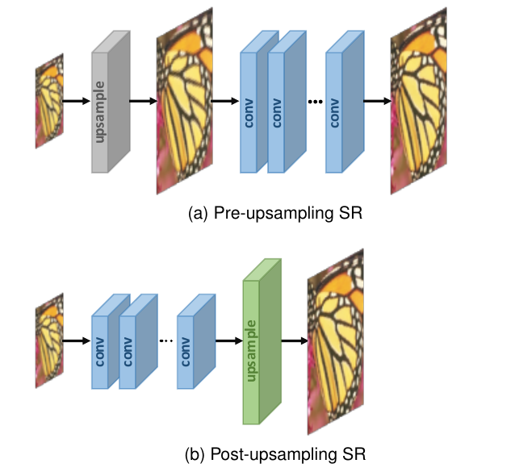
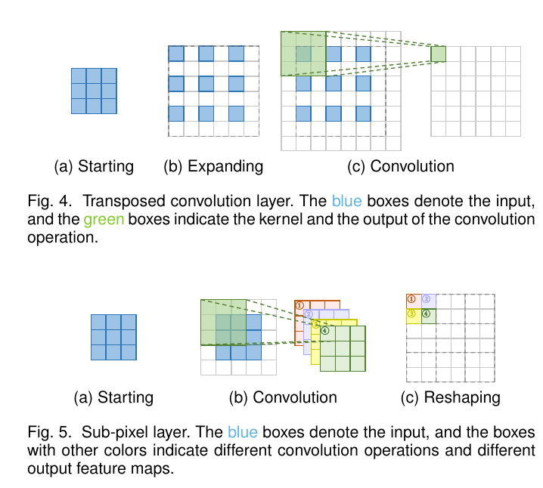
Motivation:

Slide 3
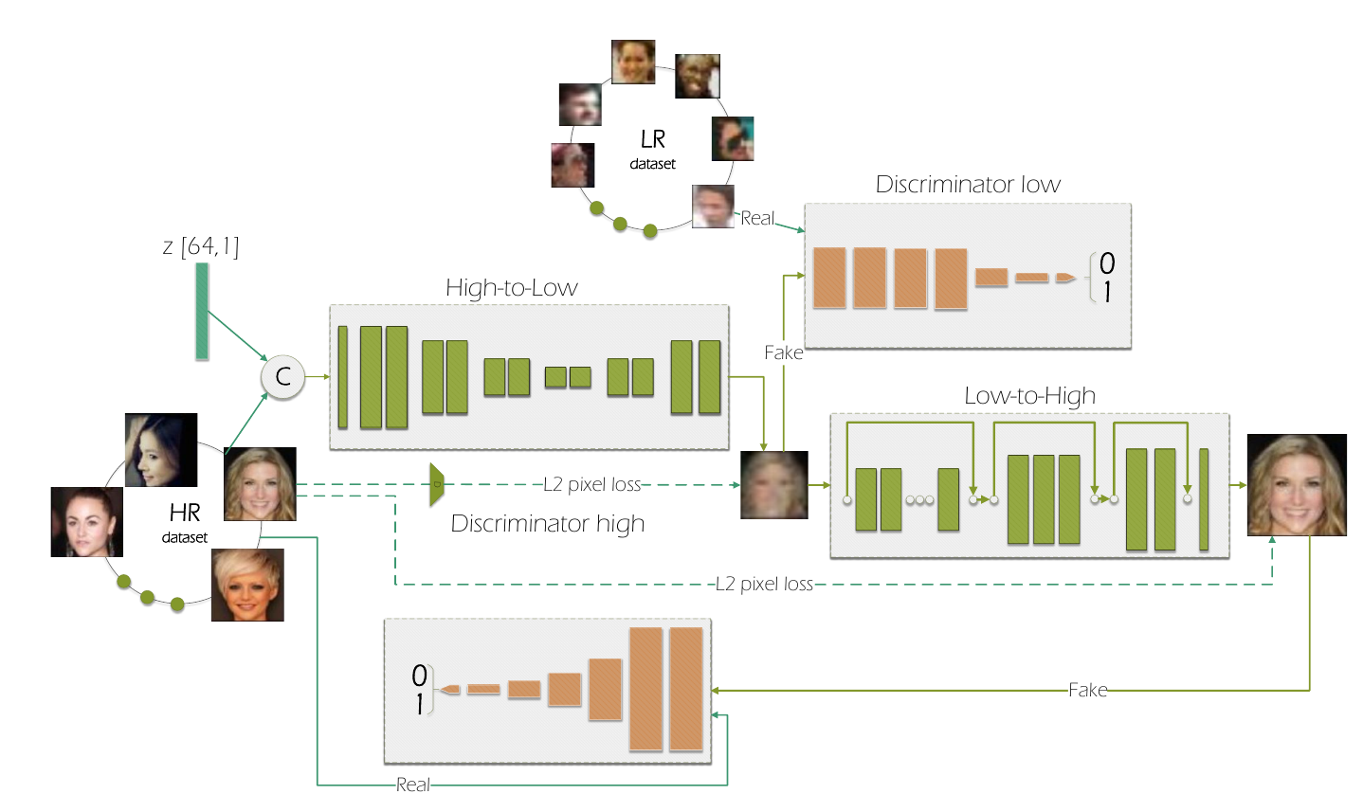
Previous work: (ECCV 2018)
High-to-Low: unpair
Low-to-High: pair
To learn image super resolution, use a GAN to learn how to do image degradation first. (ECCV 2018)

Slide 4
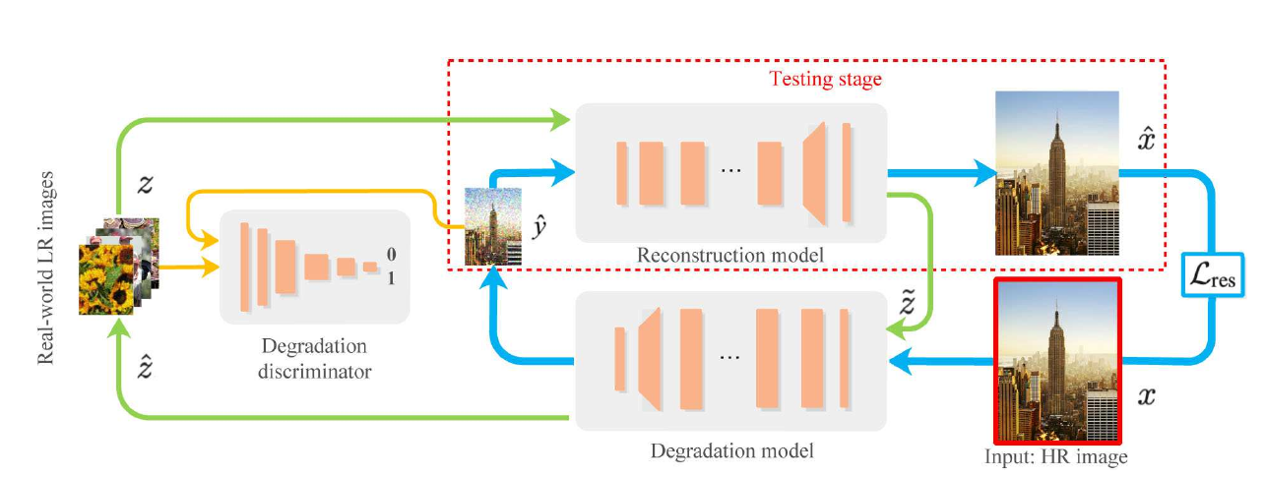





Framework (totally unpair):
(With GAN loss only, it's hard to preserve the structure similairty.)

Slide 5
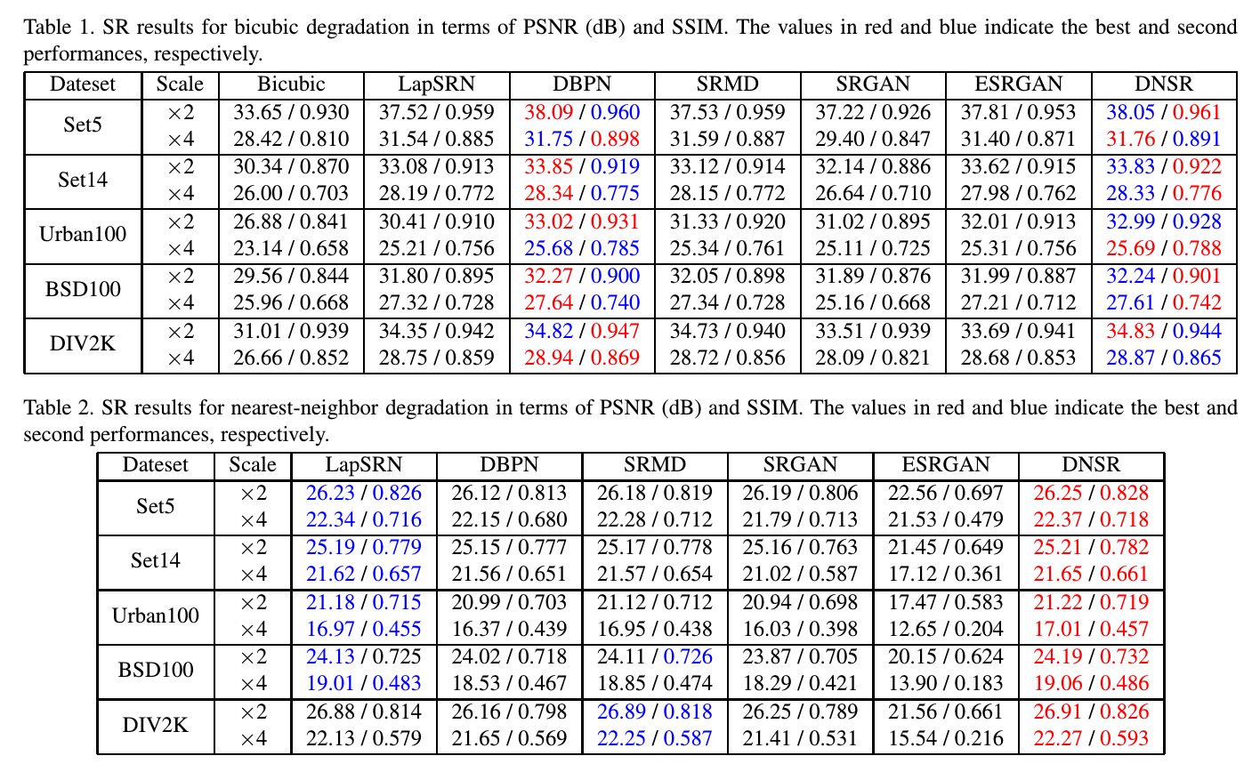
Performance:

Slide 6




Performance:

